Slide 1
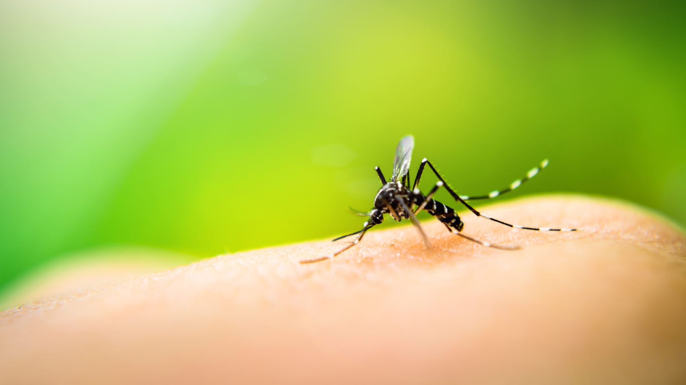
Population dynamics of the invasive Aedes albopictus mosquitoes in Iowa
Rebekah Reynolds
December 10th
EEB 590

Slide 2
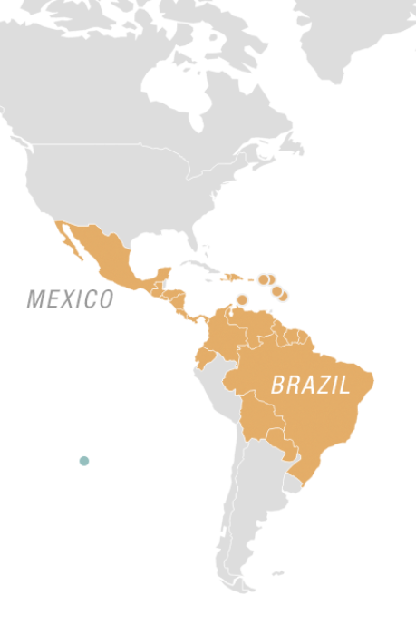
Aedes mosquitoes vector Zika virus
Zika virus epidemic occurred in 2015-2016
Mosquito vectors: Ae. aegypti and Ae. albopictus
CDC 2016

Slide 3
Aedes species distribution is questioned
Redescribed species distribution caused concern in the United States
Ae. aegypti and Ae. albopictus can potentially survive in Iowa

Slide 4
ISU mosquito surveillance program
Zika vectors were not found in Iowa during the summer of 2016
Question: Will invasive Aedes mosquitoes appear in summers 2017 or 2018
Hypothesis: We will find invasive Aedes mosquitoes in following years of mosquito surveillance

Slide 5
Mosquito surveillance methods
New jersey light trap
Mosquito collection
Species identification
Total mosquitoes per week
Week 22: End of May
Week 40: End of September
Measurements:
Count- Ae. aegypti and Ae. albopictus
Predictor- Week of the year (WOTY)

Slide 6
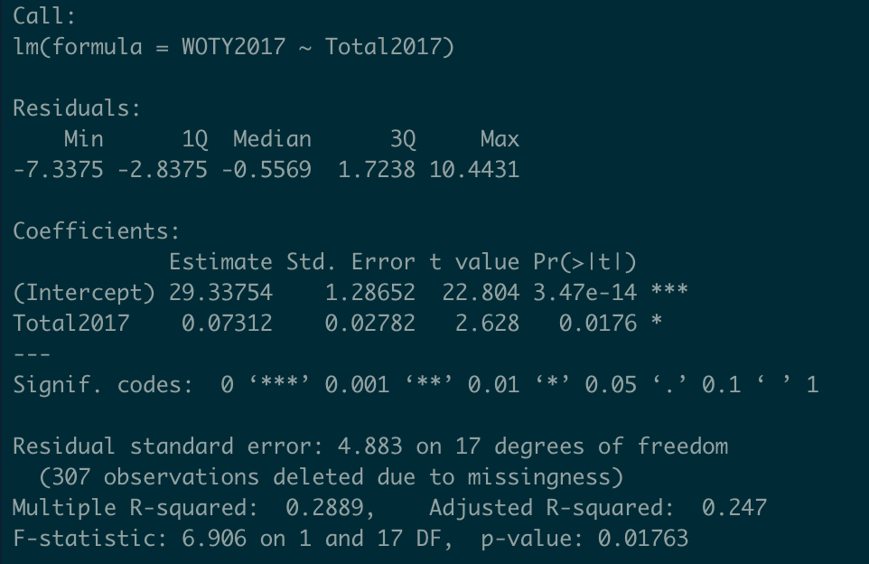
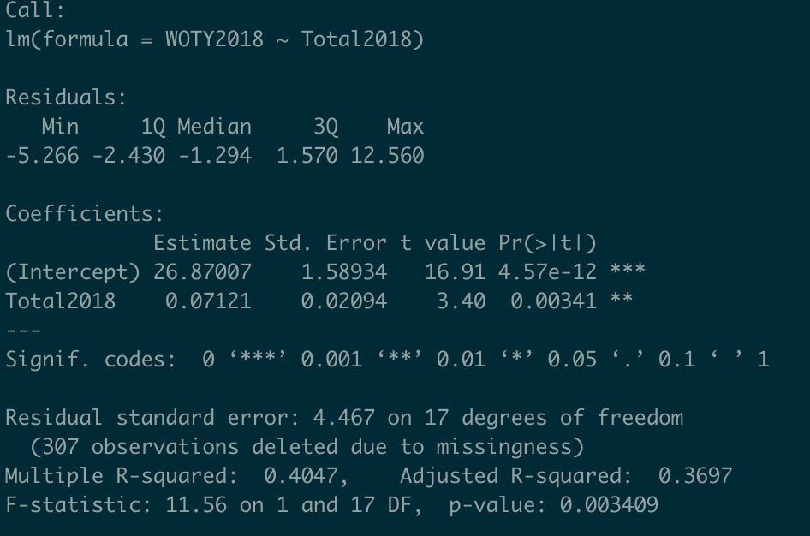
Data analysis
Approach: linear model
2017
2018

Slide 7
Data analysis
Importance of predictors:
Total number of Ae. albopictus is significantly affected by WOTY that mosquitoes collected in 2017 and 2018
2017
2018

Slide 8
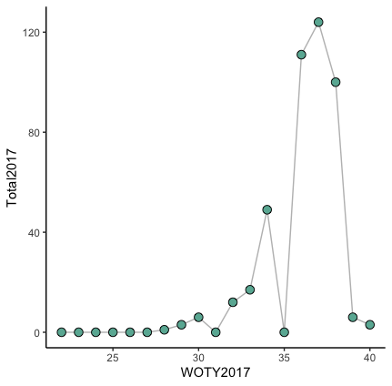
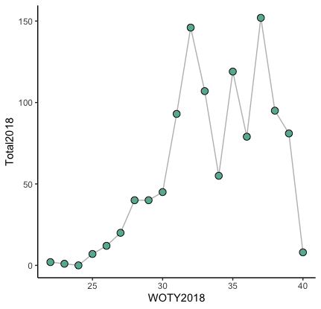
Ae. albopictus are found during 2017 and 2018 summers in Iowa
2017
2018
Total Ae. albopictus mosquitoes
Total Ae. albopictus mosquitoes
Week of the year (WOTY)
Week of the year (WOTY)

Slide 9
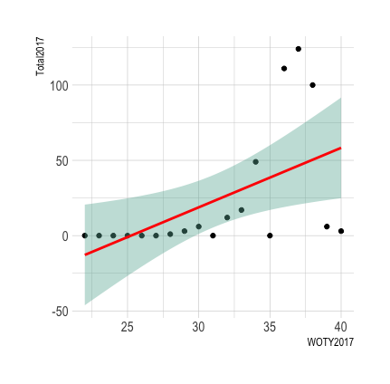
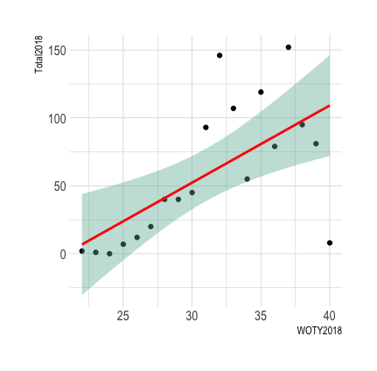
Ae. albopictus are found during 2017 and 2018 summers in Iowa
2017
2018
Total Ae. albopictus mosquitoes
Total Ae. albopictus mosquitoes
Week of the year (WOTY)
Week of the year (WOTY)

Slide 10
Ae. albopictus are found during 2017 and 2018 summers in Iowa
Ae. albopictus mosquitoes were found in Iowa two years in a row
-Likely overwintering in Iowa
-Number of Ae. albopictus increases from 2017- 2018

